Slide 2

Auto-Mobile Loan Approval System
Sri Lanka Institute of Information Technology
Group 04
Mining Minds

Slide 3
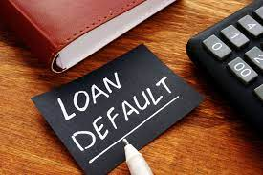
Project Overview
Develop a system to predict loan defaults.
Focus on automobile loans, which are highly susceptible to defaults.
Provides NBFIs with a data-driven decision-making tool to reduce risks.

Slide 4

Project Background
Current Economic Challenges
The economy is experiencing a financial crisis marked by rising inflation and interest rates.
Consumers are under significant financial pressure
Role of NBFIs
Non-Banking Financial Institutions (NBFIs) provide essential services, including
Investment consultancy
Risk pooling
Savings
Market brokerage

Slide 5
Project Background
Increasing Loan Defaults
NBFIs face rising loan defaults, especially in the automobile loan sector.
Public transport unreliability leads households to rely on private vehicle ownership, making automobile loans a significant portion of total loans.
These loans are highly susceptible to defaults and do not typically generate financial returns for consumers.
The increase in defaults has negatively impacted the profitability of NBFIs, which often serve clients with lower credit standards.

Slide 6
Project Background
Need for Enhanced Risk Assessment
NBFIs are enhancing risk assessment models to evaluate the financial strength of borrowers better
Analyzing historical loan default data allows a more accurate assessment of clients' repayment capacities.
Predictive Model Goals
Develop a predictive model to evaluate the likelihood of clients defaulting on automobile loans.
The model aims to help NBFIs make informed lending decisions by accurately predicting repayment ability.

Slide 7

Business Goal
Reduce Loan Defaults
Enhance Risk Assessment
Streamline Loan Approval Process
Support Financial Stability
Enhance Decision-Making
Increase Profitability

Slide 8




Technology

Slide 9






Libraries

Slide 10
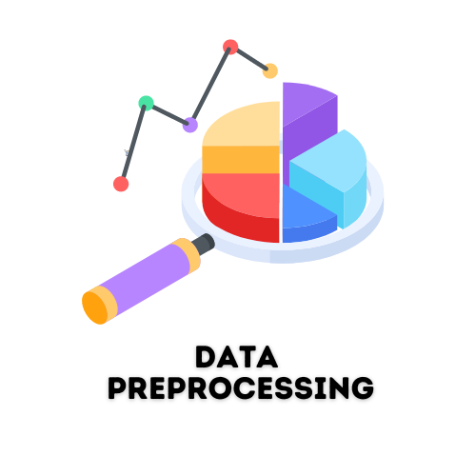
Data Preprocessing
The data preprocessing phase took 2 weeks to be completed which was the longest phase.
The dataset was obtained from Kaggle.
The dataset was not cleaned.
We had to go through null values handling, filling missing data, correcting columns with the wrong data type, removing duplicates, outlier treatments, encoding of categorical data, and data normalization.
Best features were selected to give the best accuracy.

Slide 11
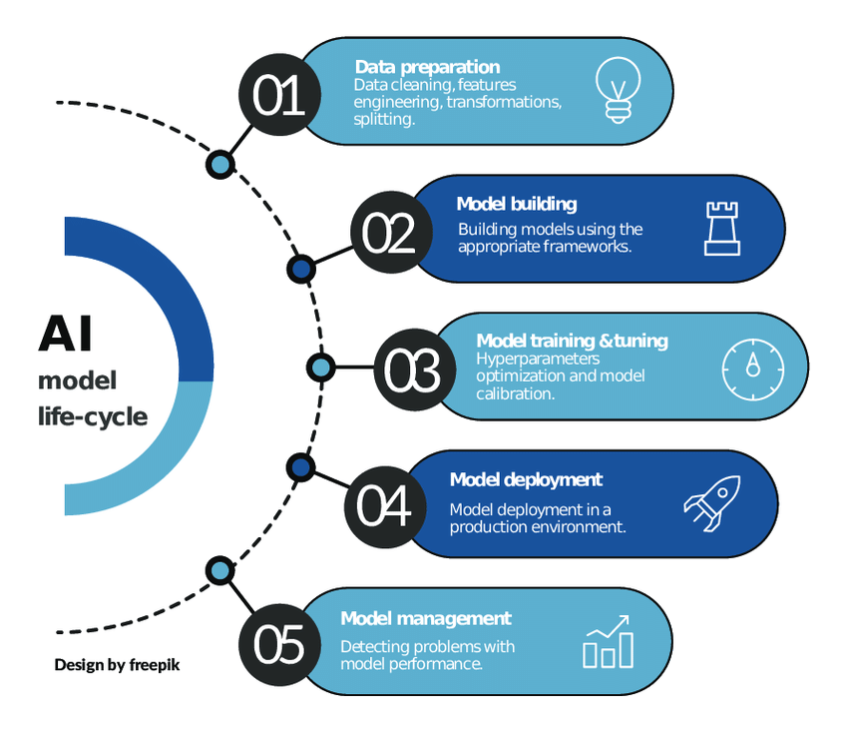

Model Implementation

Slide 12
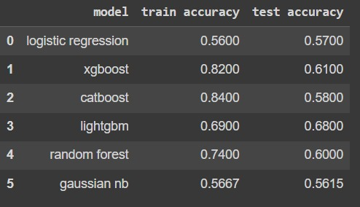
Model Training
Six models were trained for this project.
1. Random Forest Classifier
2. XGBoost
3. CatBoost
4. LightGBM
5. GaussianNB
6. Logistic Regression.
Out of the models we chose the model with the best f1 scores

Slide 13
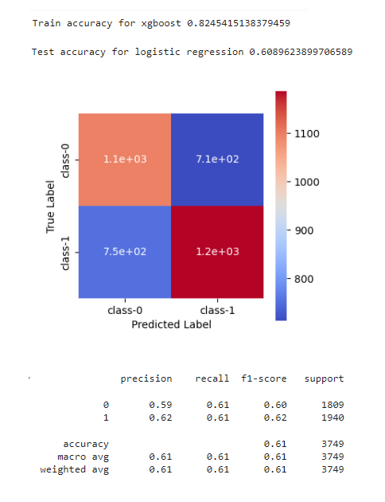
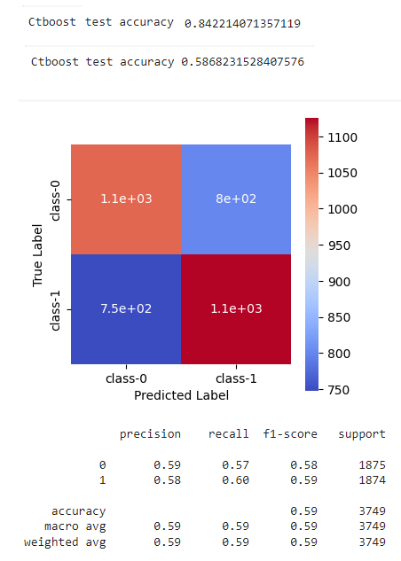
Model Building
XGBoost (Extreme Gradient Boosting)
CatBoost

Slide 14
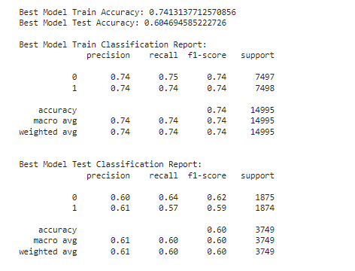
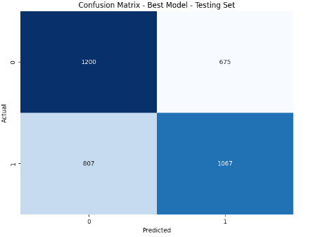
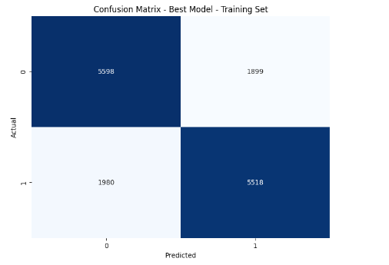
Model Building
Random Forest

Slide 15

Apply Explainable AI techniques on our finalized model
1. It is not an option to retain machine learning models as a black box.
2. There is a need for transparency, accountability and trust in AI systems.
3. We applied 3 XAI techniques
1) Feature importance
2) Feature Permutation Importance
3) Partial Dependence Plots
4. XAI provides actionable insights into how models make predictions, ensuring it can be trusted and used effectively.

Slide 16
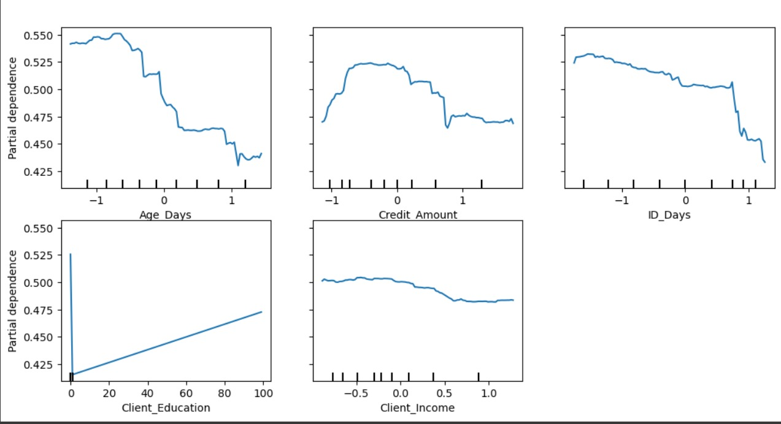
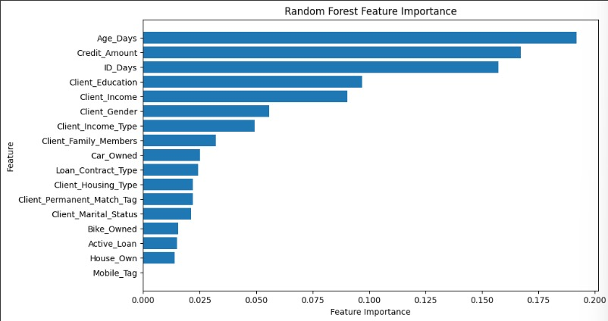
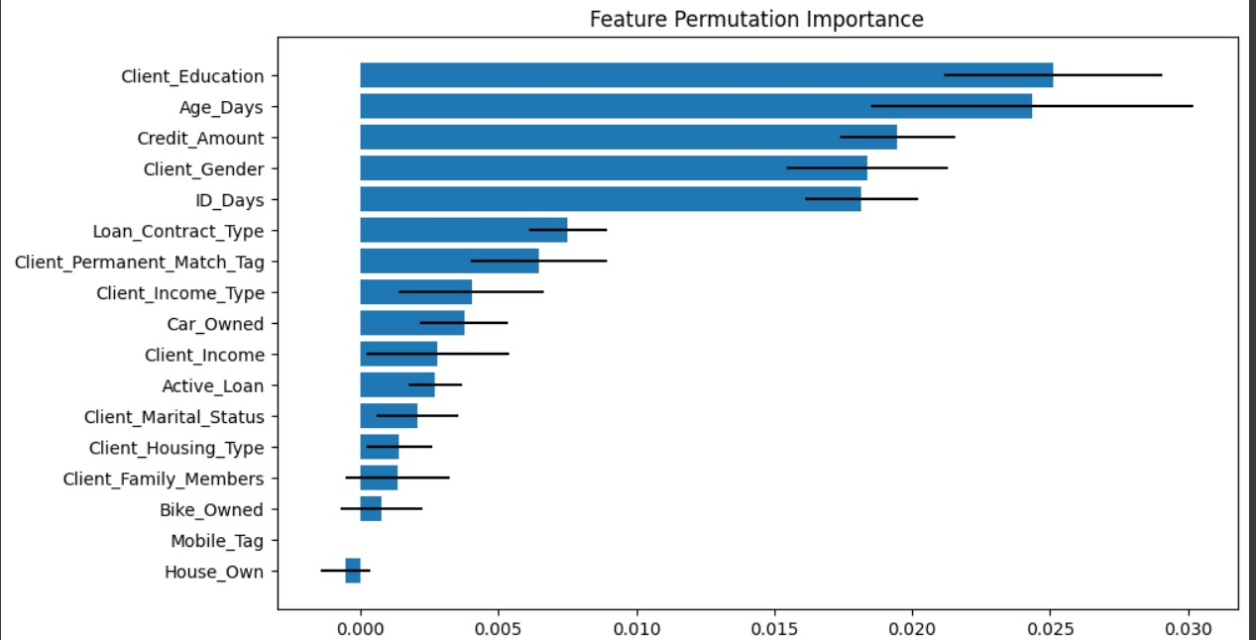

Slide 17

Challenges Faced and Solutions
Handling Missing Values
Solution:
Use mean imputation for missing numerical values and remove features with excessive missing data to maintain dataset quality
Data Imbalance
Solution:
Apply under-sampling techniques to balance the dataset and ensure the model can effectively predict both default and
non-default cases.

Slide 18
Challenges Faced and Solutions
Outliers in Data
Solution:
Identify and treat outliers through data visualization and adjustment methods to ensure a more reliable dataset.
Complexity of Risk Assessment
Solution:
Develop a comprehensive risk assessment model incorporating multiple financial indicators, allowing for a nuanced evaluation of each applicant.

Slide 19

Further Implementation
Use more accurate data preprocessing methods
Model Optimization
Goal: Improve model accuracy and performance.
Action: Explore advanced machine learning algorithms such as:
Ada Boost
Gradient boosting machines
Neural networks
Outcome: Regularly evaluate and adjust model parameters to achieve optimal results.

Slide 20

Demonstration of the Software Solution
Overview of the User Interface
Show the main dashboard where loan officers can access different functionalities.
Features:
Highlight user-friendly navigation and design elements.
Data Input Process
Enter details such as income, loan amount, Age, and etc.
Use sample data for demonstration.

Slide 21
Demonstration of the Software Solution
Running the Prediction Model
Showcase the process of initiating the loan default prediction.
Action:
Click on the “Predict” button and show the system processing data.
Displaying Prediction Results
Present the output of the prediction model.
Details:
Indicate whether the client is classified as “High Risk” or “Low Risk.”

Slide 22
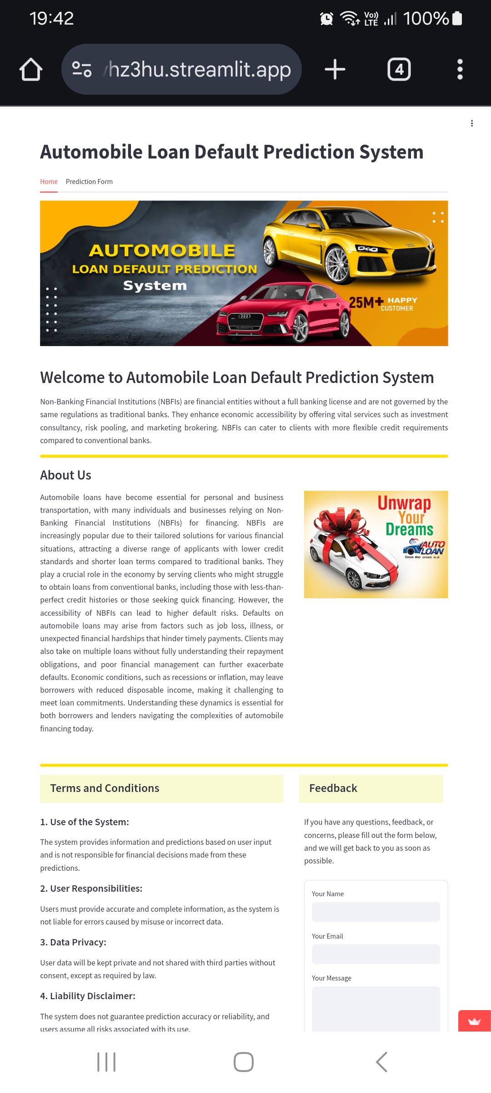
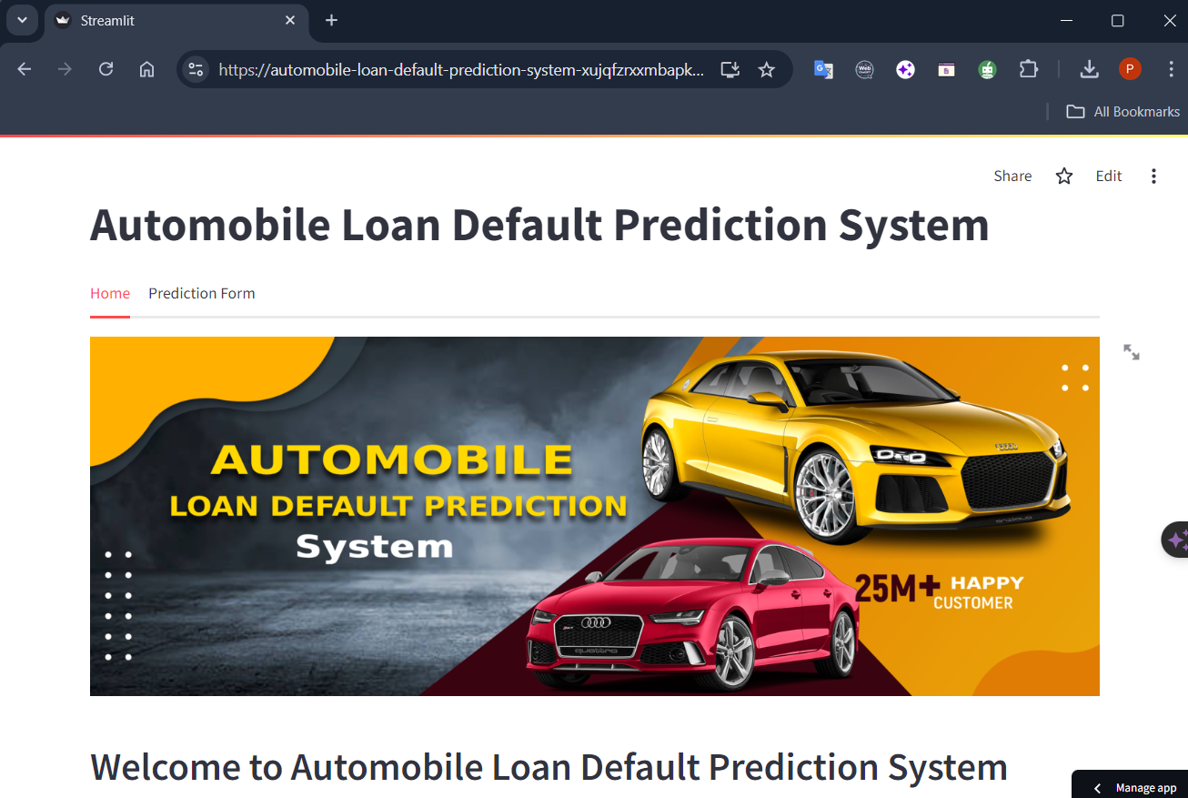
Deploying the App

Slide 23
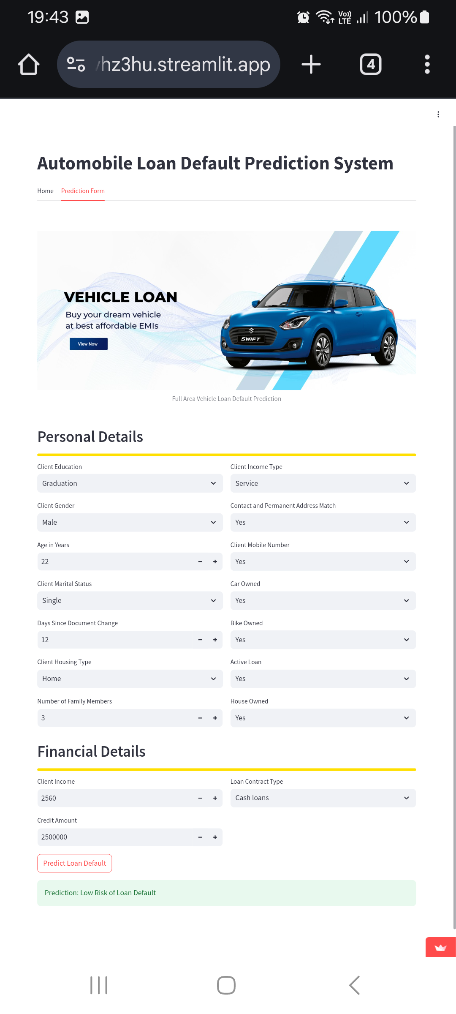
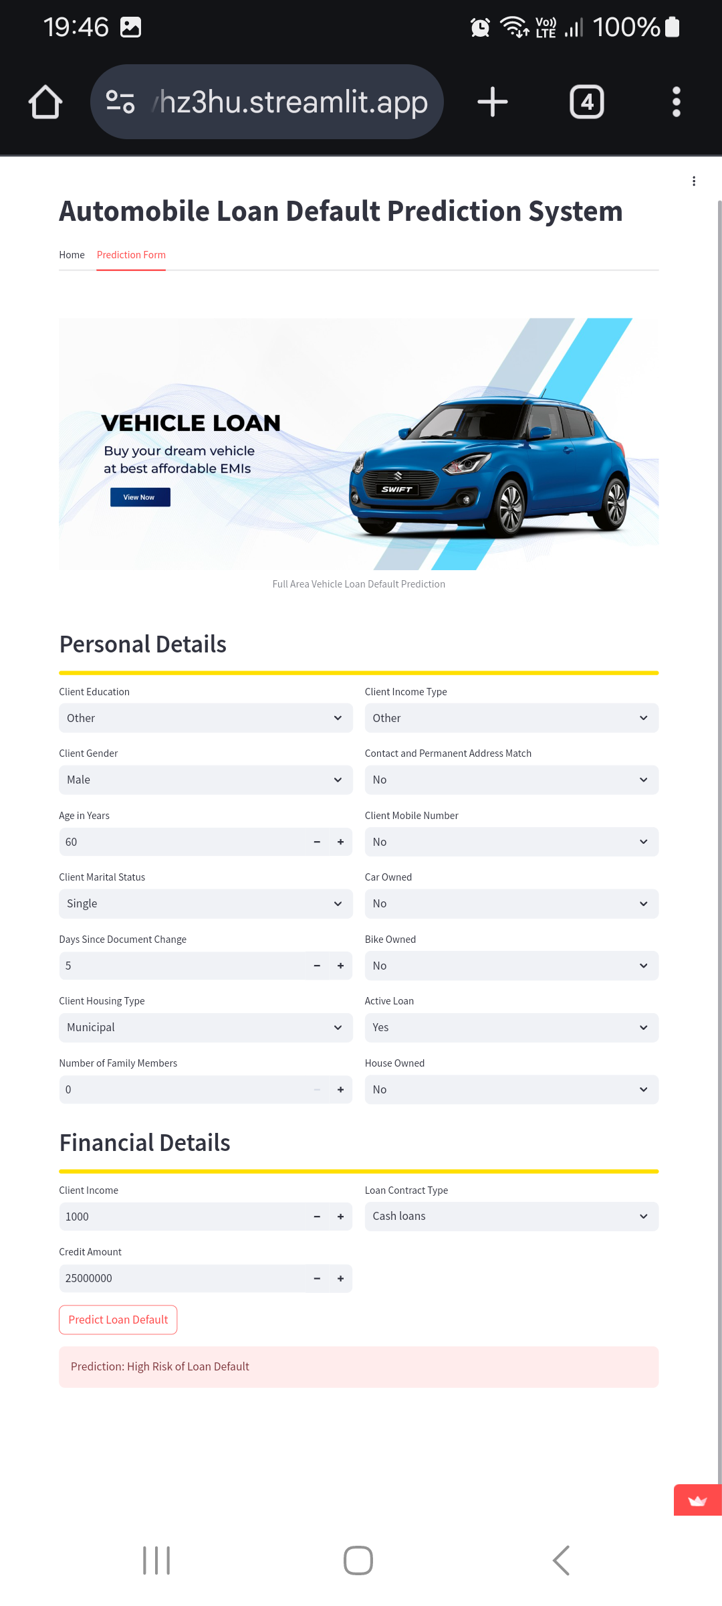

Displaying
Prediction Results

Slide 24


